Slide 1
ARM vs RISC-V
Melika Rajabi

Slide 2
OUTLINE
What is ISA
Why is ISA important
The Story Begins
RISC Design Principles
Why RISC
Exploring ARM ISA
ARM vs Thumb
Registers
Operations
What is Cortex
ARMv8
ARM Licensing Model
Which Companies Use ARM
ARM Product Code Description
ARM Advantages
Exploring RISC-V ISA
Registers
Operations
Memory Model
RISC-V Evolution Over Time
What is Open-Source
Open-Source Advantages
What is Modular Design
Some RISC-V extensions
RV32I, RV64I, RV128I
M, A, F,D
Which Companies Adopt
RISC-V
ARM or RISC-V
References
ARM ABI
ARM Evolution Over Time

Slide 3


What is an ISA?
An Instruction Set Architecture (ISA) refers to the set of instructions that a computer processor understands and can execute.
An Instruction Set Architecture (ISA) refers to the set of instructions that a computer processor understands and can execute.
The interface between low-level hardware implementation and higher-level software programming of a computer system.
It defines …
the operations that a processor can perform
the data types it can handle
the memory model it uses
The registers available for storing data
Software compilers and assemblers translate high-level programming languages or assembly code into the machine code instructions specific to a particular ISA.

Slide 4
Why is ISA important?
Because it …
Provides a standardized way for software developers to write programs that can run on different computer systems. (as long as they adhere to the same ISA.) Software compatibility and portability
Enables software developers to write a software program or application that will efficiently work with a particular computer system
Reduces the complexity of programming by providing a standard interface between hardware and software

Slide 5

The story begins …
ISAs can vary widely, depending on the architecture and design principles of the processor. Some popular ISAs include x86, ARM, MIPS, PowerPC, and RISC-V.
ISAs can be classified into different categories based on their design philosophy:
Complex Instruction Set Computer (CISC): Large & diverse set of instructions that can perform complex operations
Reduced Instruction Set Computer (RISC): Simpler & more streamlined set of instructions that typically execute in a single clock cycle

Slide 6
RISC Design Principles
Simple Instructions
Register-to-Register Operations
Simple Addressing Modes
Large Register Set
Fixed Length
So that each can execute in one cycle
Just load/store operations can access memory
To have simpler control unit
All operations except load/store use register based addressing
load/store use memory addressing modes
Large number of registers required for reg-to-reg operations
Provide ample opportunities for the compiler to optimize their usage
Instruction lengths are fixed
Implementation & execution efficiency
Efficient decoding & scheduling

Slide 7
Why RISC?
One instruction, One operation
Fast to execute
Any register can be used for any purpose
Simple & Fast to decode
Simple circuit
Larger but Simpler code size
Reduced & Simple instructions
Produce more efficient code

Slide 8

ARM
Advanced RISC Machines

Slide 9

Exploring ARM ISA
RISC based ISA
IRQ : entered when a low priority (normal) interrupt is raised
Supervisor : entered on reset and when a Software Interrupt instruction is executed
Abort : used to handle memory access violations
Undef : used to handle undefined instructions
System : privileged mode using the same registers as user mode
2 separate instruction set states:
32-bit ARM
16-bit Thumb
7 basic operating modes:
User : unprivileged mode under which most tasks run
FIQ : entered when a high priority (fast) interrupt is raised

Slide 10
ARM state features
Thumb state features
Works on 32-bit values, produces 32-bit addr for mem access
3-address data processing instructions
Conditional execution of each instruction
Access to low registers (r0 - r7) similar to ARM state
Restricted access to high registers (r8 - r15), MOV, ADD, CMP can access
Shift and ALU operations in single instruction
Is enabled by 'T' bit (if set) of CPSR
If enabled, fetches 16-bit code from HW aligned addresses, PC is incremented by two bytes
Load-Store and Load-Store multiple instructions
New Instructions: LSL, LSR, ASR, ROR (barrel shifter can't be combined with any instruction)
Single cycle execution of all instructions
Not conditionally executable (except 'B' branch instruction)
Instruction set extension through coprocessor instructions
Instructions removed: MLA, RSB, RSC, MSR, MRS, SWP, SWPB and coprocessor instructions

Slide 11
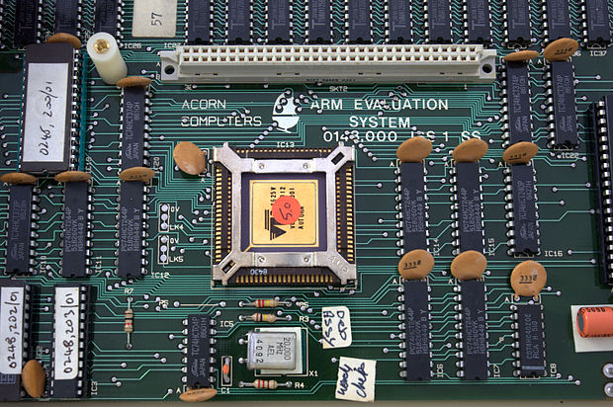
REGISTERS
ARM has 37 registers all of which are 32-bits long
1 dedicated program counter (pc)
1 dedicated current program status register (cpsr)
5 dedicated saved program status registers (spsr)
30 general purpose registers

Slide 12
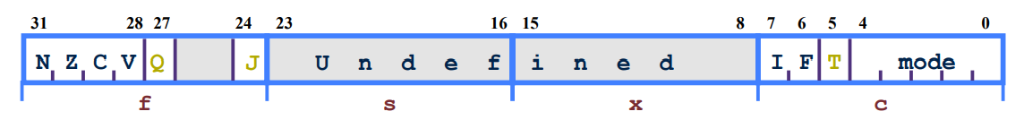

Program status registers (cpsr & spsr)
Sticky Overflow flag - Q flag:
Indicates if saturation has occurred
Mode bits:
Specify the processor
mode
Interrupt Disable bits:
I = 1: Disables the IRQ
F = 1: Disables the FIQ
T Bit:
T = 0: Processor in ARM state
T = 1: Processor in Thumb state
Condition code flags:
N = Negative result from ALU
Z = Zero result from ALU
C = ALU operation Carried out
V = ALU operation overflowed
J bit:
J = 1: Processor in Jazelle state
8-bit Jazelle instruction mode is a mode that allows java bytecode to be directly executed in ARM architecture in order to improve performance.

Slide 13
Program counter (pc)
When the processor is executing in …
Thumb state:
- All instructions are 16 bits wide
- All instructions must be halfword aligned (2 bytes)
- The pc value is stored in bits [31:1] with bit [0] undefined (as instruction cannot be byte aligned)
ARM state:
- All instructions are 32 bits wide
- All instructions must be word aligned (4 bytes)
- The pc value is stored in bits [31:2] with bits [1:0] undefined (as instruction cannot be halfword or byte aligned)
Jazelle state:
- All instructions are 8 bits wide
- Processor performs a word access to read 4 instructions at once

Slide 14
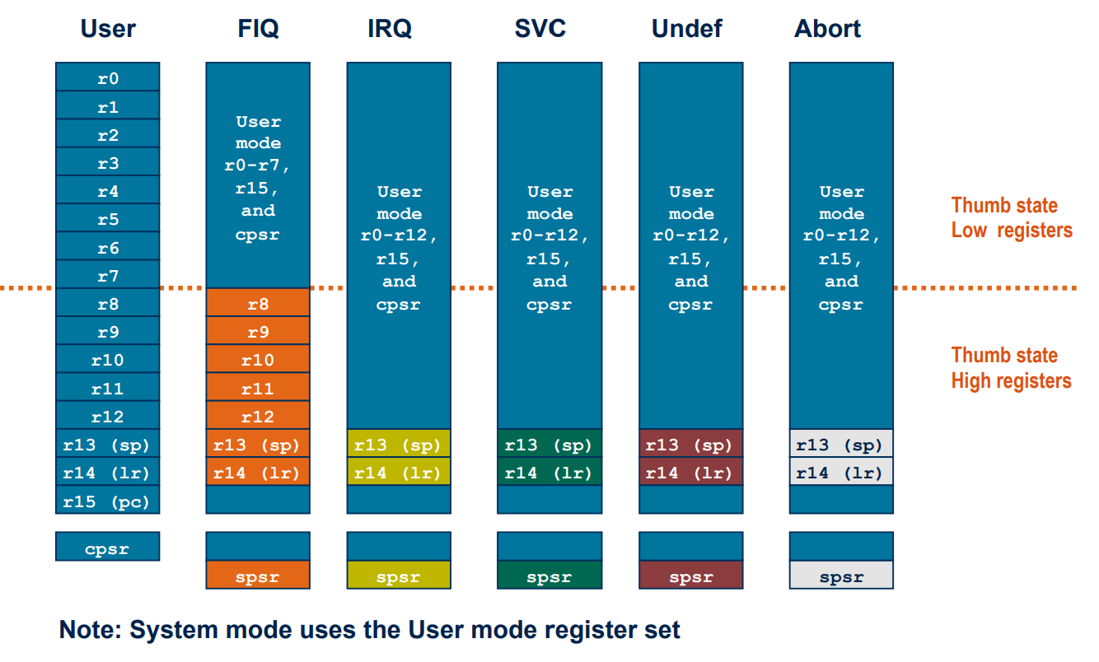
As it is shown, each mode has access to a particular register set from all 37 registers.
Note that in all cases, just 32 registers are visible and others are banked out.

Slide 15
OPERATIONS
Data processing instructions
Branch instructions
Load-Store instructions
Software interrupt instructions
Program status register instructions
Coprocessor instructions
ARM state

Slide 16
Data processing Instructions
1/3
16 basic instructions (excluding two basic multiply instrs.)
Move, Arithmetic, Logical, Compare and Multiply operations
Operate on two 32-bit operands, produce 32-bit result
All operations except multiply instructions are carried out in ALU
Multiply instructions are carried out in multiplier block
Do not access memory
Can pre-process one operand using barrel shifter

Slide 17
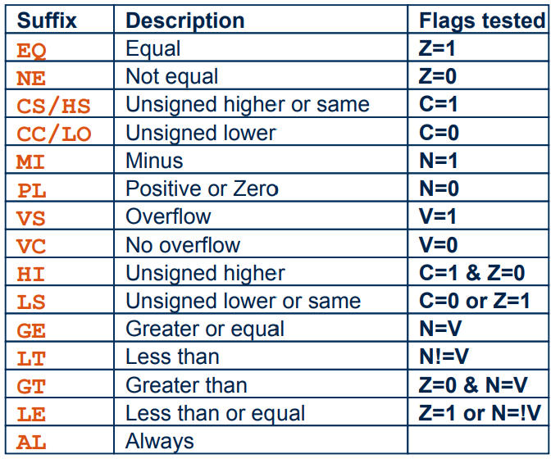
Data processing Instructions
2/3
Default: AL
Syntax:
<opcode>{<cond>} {S} Rd, Rn, n
“cond”: Indicates flags to test
“S”: Set condition flags in CPSR
“Rd”: Destination
“Rn”: 1st operand
“n”: May be “Rm”, “#const” or “Rs, <shift | rotate> n”
Rn/Rm/Rs remains unchanged
Condition codes & Flag states tested

Slide 18
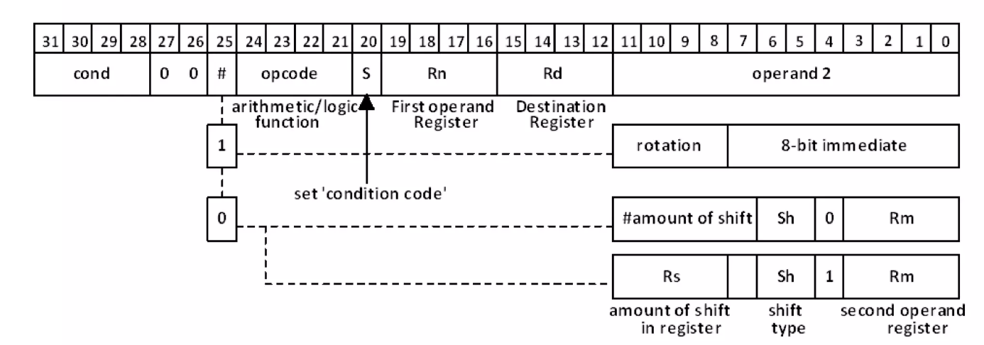
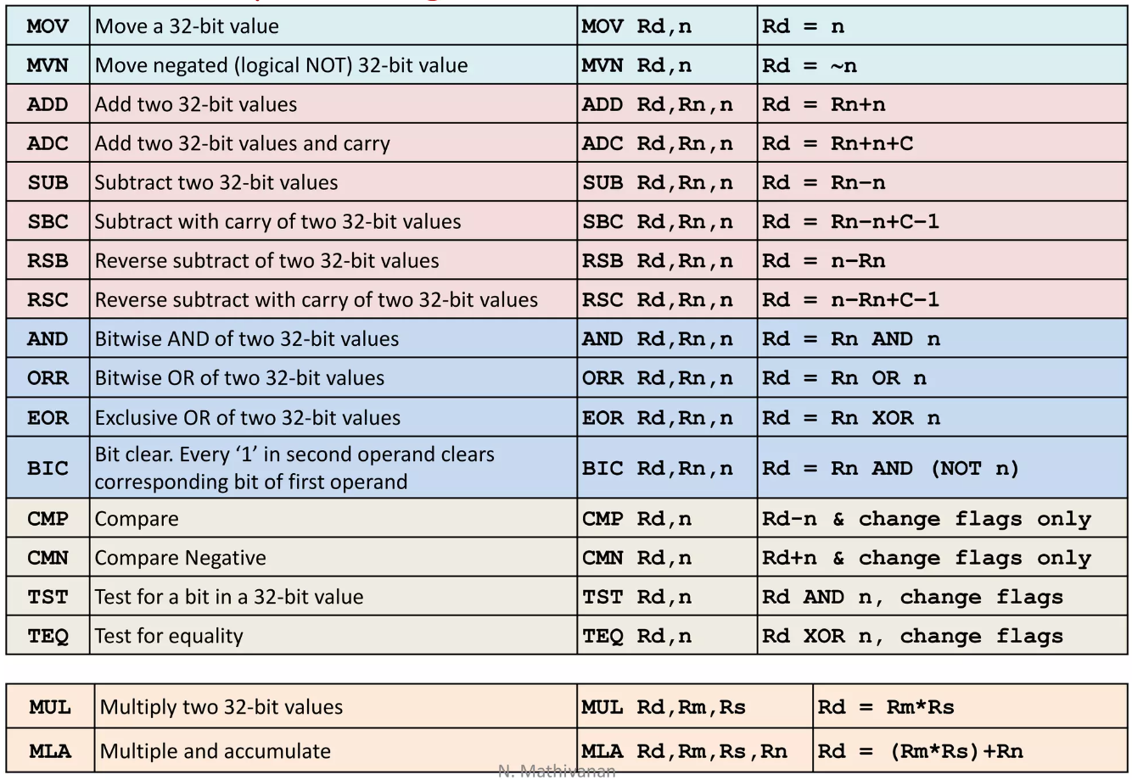
Data processing Instructions
3/3
Binary encoding
List of instructions

Slide 19
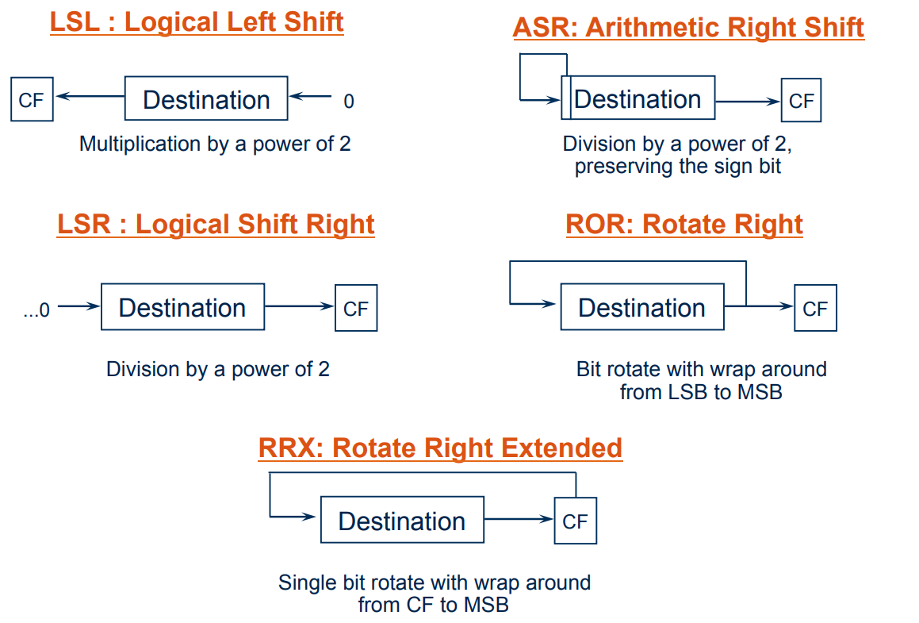
Barrel Shifter

Slide 20
Immediate Constant
No ARM instruction can contain a 32 bit immediate constant
To allow larger constants to be loaded, the assembler offers a pseudo-instruction:
LDR rd, =const
This will either:
1. Produce a MOV or MVN instruction to generate the value (if possible)
Or
2. Generate a LDR instruction with a PC-relative address to read the constant from a literal pool (Constant data area embedded in the code)

Slide 21
Other Multiply Instructions
[U|S] MULL {<cond>} {S} RdLo, RdHi, Rm, Rs
RdHi , RdLo = Rm * Rs
[U|S] MLAL {<cond>} {S} RdLo, RdHi, Rm, Rs
RdHi , RdLo = (Rm * Rs) + RdHi, RdLo

Slide 22
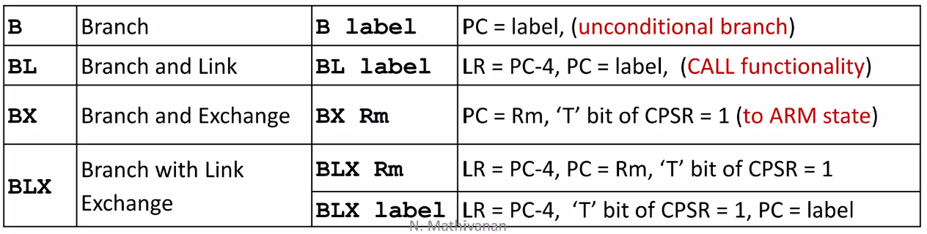
Branch Instructions
1/2
Divert sequential execution / CALL a subroutine
Range: +/- 32 MB from current position (i.e. PC-8), PC relative offset
Has 24 bits allocated for specifying word offset
With 24-bit offset append '00' at LSB, extend sign bit, place into PC
PC is set to point to new address
Syntax:
Branch : B{<cond>} label
Branch with Link : BL{<cond>} subroutine_label

Slide 23
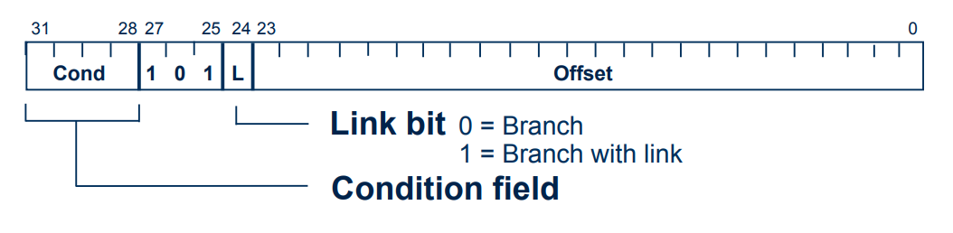
Branch Instructions
2/2
Binary encoding
BL stores return address in LR
For non-leaf functions, LR will have to be stacked

Slide 24

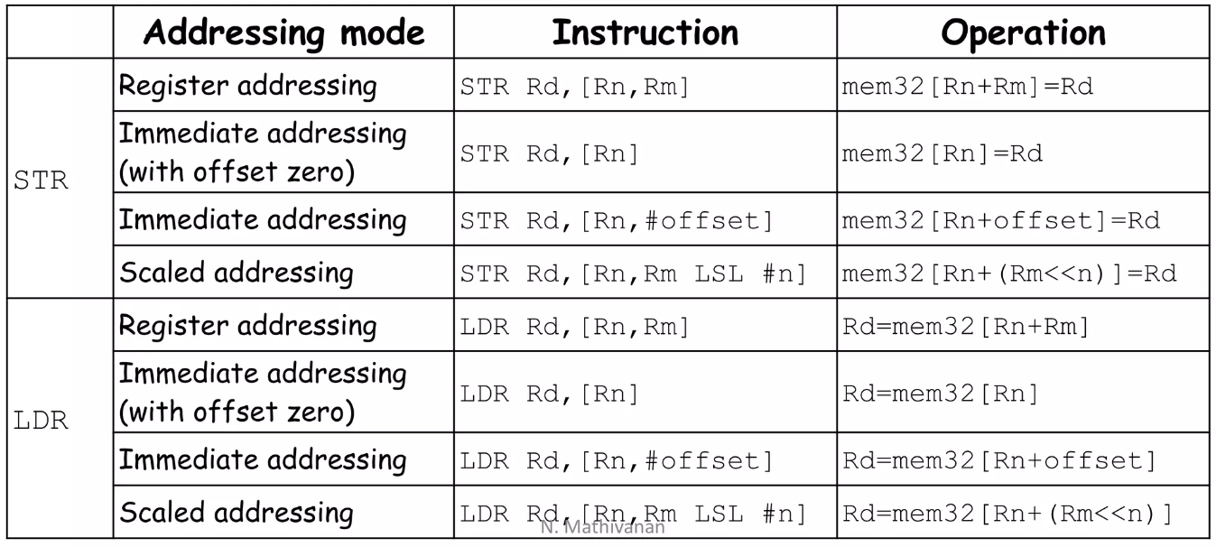
Load/Store Instructions
1/4
Single Transfer Instruction
Transfers boundary aligned Word/HW/Byte between mem & reg
Address of mem loc. is given by Base Addr. +/- Offset
There are some methods of providing offset (Addressing modes):
Register addressing - A register contains offset
Immediate addressing - Immediate constant is offset
Scaled addressing - Offset in a reg is scaled using shift operation

Slide 25
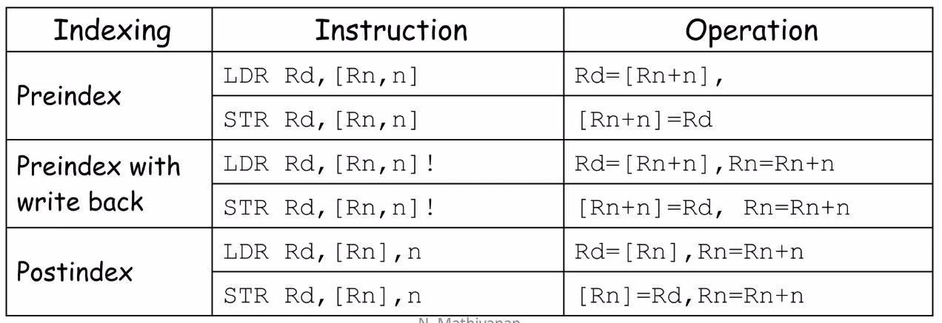
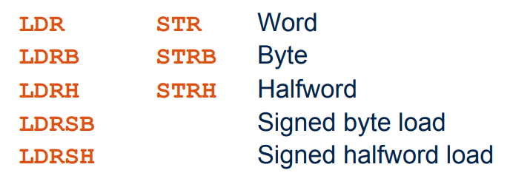
Load/Store Instructions
2/4
Choice of pre-indexed or post-indexed addressing
Syntax:
<opcode>{<condition>} {<type>} Rd, [Rn{,<offset>}]
“type”: H, HS, B, BS
“Rd”: source/destination register
“Rn”: Base address
“<offset>”: “Rm” or “#(0-4095)” or “Rm, <shift>#n”

Slide 26
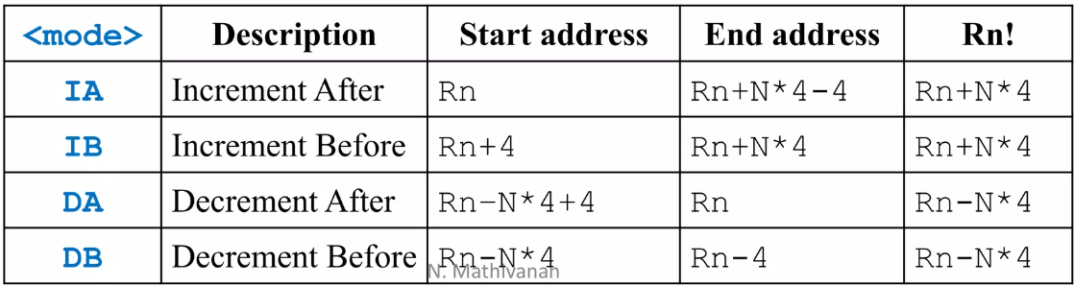
Load/Store Instructions
3/4
Multiple Transfer Instruction
Transfers data between multiple regs & mem in single instruction
Useful in stack, block move, temporary store & restore
Advantages: small code size, single instruction fetch from memory
Disadvantages: can't be interrupted, increases interrupt latency
Syntax: LDM, STM
<opcode>{<cond>} <mode>Rn{!}, <registers>
“Rn”: Base register
“!”: Update base reg. after data transfer (option)

Slide 27
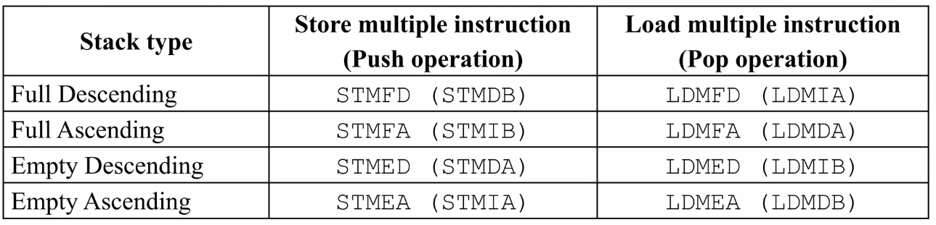
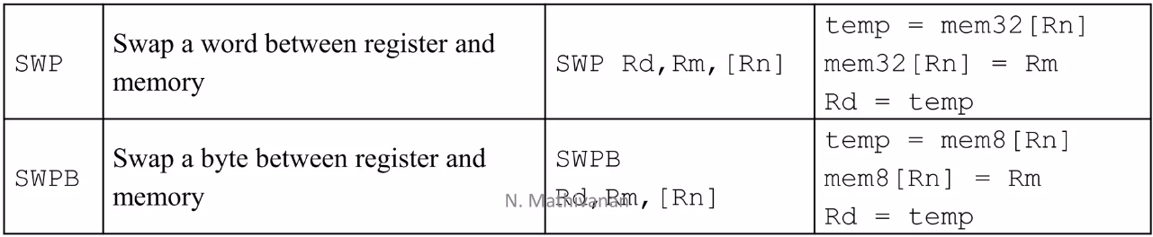
Load/Store Instructions
4/4
Stack operations
Alternative suffixes to IA, IB, DA and DB
Full/Empty, Ascending/Descending (FD, FA, ED, EA)
Swap Instructions (also known as semaphore)

Slide 28
Software Interrupt Instructions
Used in User mode applications to execute OS routines
When executed, mode changes to supervisor mode
Syntax: SWI{cond} SWI_number
Return instruction from SWI routine: MOVS PC, r14
Distinguish subroutine call and SWI instruction execution

Slide 29
Program Status Register Instructions
Instructions to read/write from/to CPSR or SPSR
Syntaxes:
MRS {<cond>} Rd, <CPSR | SPSR>
MSR{<cond>} <CPSR | SPSR>, Rm
MSR{<cond>} <CPSR | SPSR>_<fields>, Rm
MSR{<cond>} <CPSR | SPSR>_<fields>, #immediate

Slide 30
Coprocessor Instructions
1/2
ARM supports 16 coprocessors
Coprocessor implemented in hardware, software or both
Coprocessor contains instruction pipeline, instruction decoding logic,
handshake logic, register bank, special processing logic with its own
data path
Also connected to data bus
Instructions in program memory are available for coprocessors too
Works in conjunction with ARM core and process same instruction stream as ARM, but executes only instructions meant for coprocessor and ignores ARM and other coprocessor's instructions
3 types of instructions: Data processing, Register transfer, Memory transfer

Slide 31
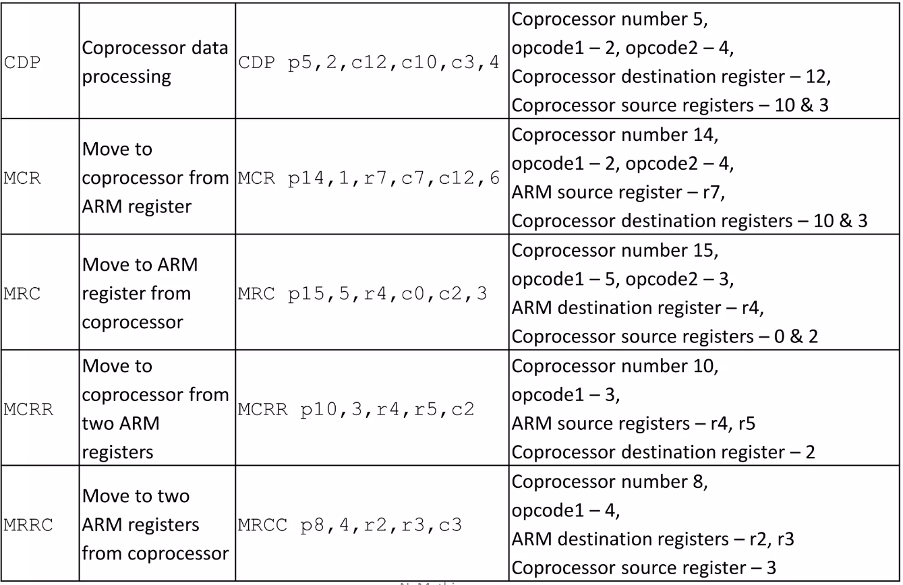
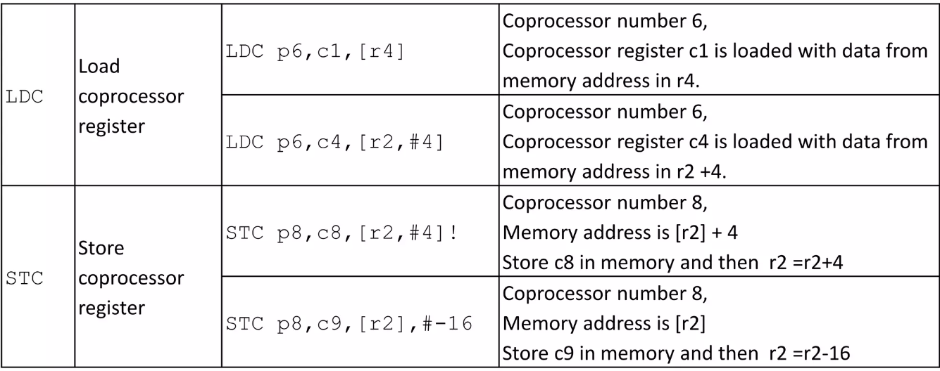
Coprocessor Instructions
2/2

Slide 32

Thumb state
Thumb uses less memory space than ARM though more instructions
Data processing instructions
2-addr format, No conditional execution, No 'S' suffix (always ON)
Load-Store instructions
Offset: register, immediate (0-124 words), relative to PC/SP
Branch instructions
Branch instruction ('B') is conditionally executable
Software interrupt instructions
MOV, MVN, ADD, ADC, SUB, SBC, MUL, AND, ORR, EOR, BIC, NEG, LSL, LSR, ASR, ROR, CMP, CMN, TST
LDR, STR, LDMIA, STMIA, PUSH, POP
B{cond{, B, BL, BX, BLX
Generates exception, Use just 8-bit interpreted value
Handler enters in ARM mode

Slide 33

ARM ABI
The ARM Application Binary Interface (ABI) is a set of conventions and rules that dictate how software components, such as applications and libraries, should interact with each other when running on ARM-
based systems. The ABI defines various aspects of software execution, including Function calling conventions, Data representation, Register usage, System libraries, Object file formats, Name mangling.
Adhering to the ARM ABI ensures that software components built by different compilers or written in different programming languages can work together seamlessly on ARM-based systems. This is essential
for creating a consistent and predictable environment for software development and execution on ARM devices.

Slide 34
From Acorn to ARM
Acorn Computers Ltd
The BBC micro used in the programme of the BBC and It became popular in U.K.
Acorn can’t find any processor ready on the market for their needs
Used in Apple II
In 1979, Acorn Atom released
Acorn makes agreement with the BBC, for a new computer design
Many U.K. Schools/research lab brought the BBC micro
More power wanted – Acorn looks for a new processor
Influenced by the Berkeley RISC I CPU
After some custom modifications by Acorn, a new RISC processor was designed!
The ARM (Acorn/Advanced RISC Machine )
They design a new processor

Slide 35

ARM Limited
ARM = RISC with a few CISC features
Founded in November 1990
(Spun out of Acorn Computers)
ARM does not fabricate silicon itself
Also develop technologies to assist with the design-in of the ARM architecture
(Software tools, boards, debug
hardware, application software, bus
architectures, peripherals etc.)

Slide 36
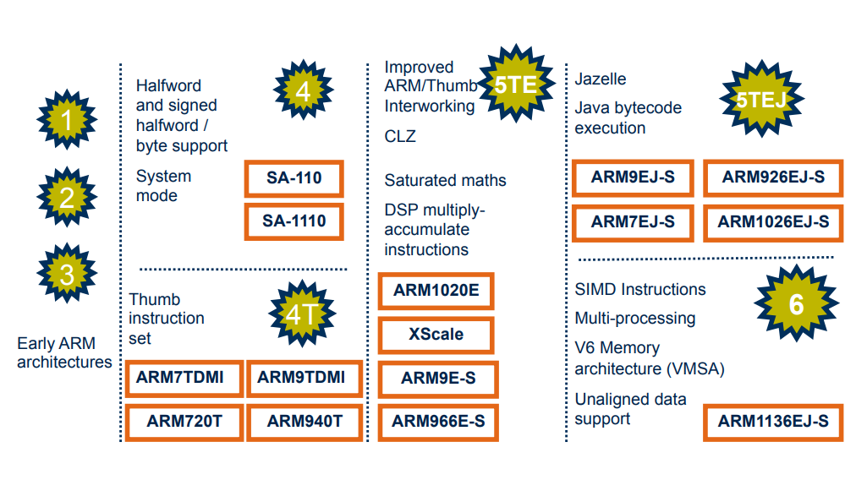
ARM Evolution

Slide 37
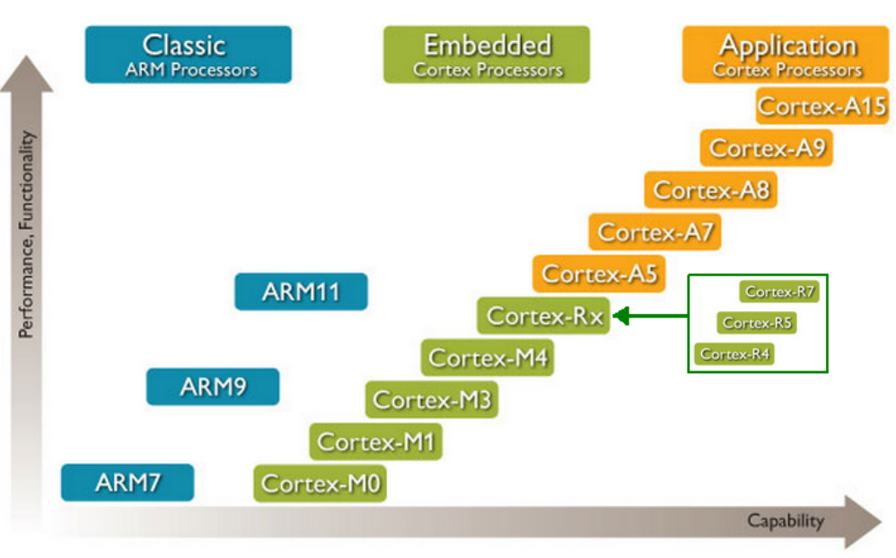
ARM Evolution

Slide 38

What is Cortex?
Cortex is a family of ARM cores that have replaced Arm's classic cores with more market-specific variations.
Cortex can be broadly categorized into three types of workloads:
Applications
Real-time (R)
Microcontroller (M)

Slide 39
Cortex-A
Designed for fully capable computers, running typical operating systems (Android, Windows, Linux, iOS). Those processors are found in anything from smartphones to tablets and laptops.
Cortex-X
Slightly enhanced version of the Cortex-A designs in order to further optimize the Cortex-A design (in terms of PPA) for certain markets or workloads
Cortex-R
Designed for real-time operating systems with very deterministic behavior. Those cores are typically less powerful than the A series and are used for things such as controllers, factory equipment, medical devices, and other machines.
Cortex-M
Designed for ultra-low power, typically small factor and low-performance systems. Those are found in cost-sensitive devices and electronics, automated systems, and many other embedded devices.

Slide 40
Let’s Focus on the ARMv8
The ARMv8 architecture is a 64-bit ISA.
It represents a significant advancement over its predecessor, ARMv7, by introducing several architectural improvements and enhancements, making it suitable for a wide range of computing devices, including smartphones, tablets, servers, and embedded systems.
One of the key features of ARMv8 is its support for two execution states: AArch32 and AArch64.

Slide 41
- The execution state that maintains compatibility with the previous ARM architectures.
- A 32-bit execution state that supports the execution of 32-bit ARM and Thumb instructions.
Backward-compatible, meaning that it can run legacy 32-bit ARM software without any modifications.
AArch64
- Also known as ARMv8-A.
- The 64-bit execution state
- Supports 64-bit memory addressing and 64-bit arithmetic operations
- Increased performance, larger addressable memory space
- Not backward-compatible with AArch32
Software designed for AArch32 cannot be executed directly in AArch64 mode and requires recompilation or emulation.
AArch32

Slide 42
Energy efficiency ARMv8 incorporates power-saving features, including improved branch prediction, instruction prefetching, and power gating, to optimize energy efficiency and extend battery life in mobile and embedded devices.
Scalability Supports a wide range of implementations, from low-power embedded devices to high-performance servers, enabling scalability across different market segments.
Other features of ARMv8
Cryptography support ARMv8 includes cryptographic instructions to accelerate encryption and decryption operations, enhancing the performance of cryptographic algorithms.
Improved security ARMv8 includes enhanced security features, such as address space layout randomization (ASLR) and pointer authentication, to mitigate security vulnerabilities and protect against exploits.
Virtualization support ARMv8 architecture includes virtualization extensions, allowing efficient and secure virtualization of resources, enabling consolidation of multiple virtual machines on a single physical device.
Increased performance The 64-bit execution state of AArch64 provides access to a larger number of registers, larger memory address space, and improved SIMD (Single Instruction, Multiple Data) capabilities, resulting in improved performance for compute-intensive workloads.

Slide 43
ARM licensing model
ARM's licensing model is based on the concept of intellectual property (IP) licensing. ARM, designs and licenses processor architectures and related technologies rather than manufacturing and selling physical chips. This approach allows ARM to focus on innovation and design, while partnering with semiconductor companies to produce chips based on their architectures.

Slide 44
Architecture License: This license grants the licensee the right to use ARM's processor architecture to design their own chips. It provides access to the instruction set architecture (ISA) and the necessary design specifications. Companies with an architecture license can create custom processors tailored to their specific requirements.
ARM offers two main types of licenses:
Processor IP License: This license provides the licensee with a pre-designed processor core, known as intellectual property (IP), which they can integrate into their own chips. ARM offers a range of processor IP cores, from low-power microcontrollers to high-performance application processors. Licensees can customize and optimize these cores to suit their target markets and applications.

Slide 45
Apple's iPhone and iPad devices use ARM-based processors. Apple's custom-designed chips, such as the Apple A-series and M-series processors, are based on ARM architecture. These chips provide high-performance and energy-efficient computing capabilities for Apple's mobile devices.
Qualcomm, a leading semiconductor company, utilizes ARM architecture in its Snapdragon processors. Snapdragon chips power many smartphones and tablets running Android operating systems. They are known for their integration of processing power, graphics performance, and connectivity features.
Samsung incorporates ARM-based processors in its mobile devices, including smartphones and tablets. Their Exynos processors, based on ARM architecture, provide computing power for Samsung's flagship devices.
NVIDIA, known for its graphics processing units (GPUs), aims to leverage ARM's architecture and expertise to enhance its GPU capabilities and expand its reach into various markets, including edge computing and artificial intelligence.
MediaTek designs and manufactures system-on-chips (SoCs) for smartphones, tablets, and other consumer electronics. Their SoCs are often based on ARM architecture, delivering a balance of performance and affordability.
Amazon's AWS Graviton processors, used in their Amazon Web Services (AWS) cloud infrastructure, rely on ARM-based architecture. These processors offer efficient and cost-effective options for cloud-based computing.
Microsoft employs ARM-based processors in its Surface Pro X devices, providing a balance between performance and battery life. They also utilize ARM architecture in their cloud services, such as Azure, for specific workloads.
Which companies use ARM?

Slide 46

ARM Partnership

Slide 47

ARM Product Code Description
M: Multiplier
ARM processor have hardware multiplier unit doing multiplication
I: Embedded ICE Macrocel
Hardware circuit used to generate trace information. Used in advance debugging.
E: Enhanced Instruction Set
J: Java Acceleration by Jazelle mode
F: Vector Floating point
Hardware implementation of floating operations.
S: Synthesizable Version
The ARM architecture can be modified as it comes in
terms of soft processor core.

Slide 48
So …
Cheap
Easy to Develop
Great Performance
Cost Sensitive Applications
Cost Sensitive Applications
Low Power Consumption
Great Computing Power

Slide 49
RISC-V

Slide 50

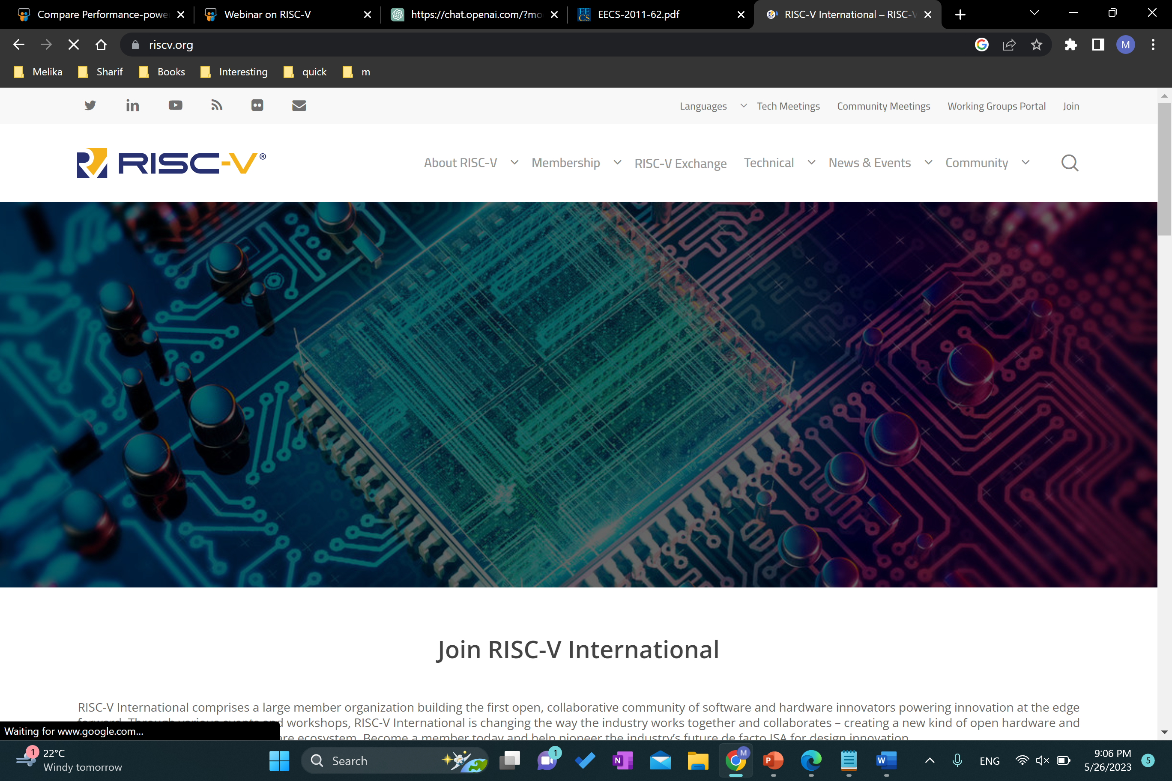
Exploring RISC-V ISA
REGISTERS
There are 31 general-purpose registers, which hold fixed-point values + 1 register hardwired to the constant 0.
For RV64, the registers are 64 bits wide, and for RV32, they are 32 bits wide.
+ There are 32, 64-bit registers, which hold single- or double-precision floating-point values.
+ There are 2 special user-visible registers. The program counter (pc) holds the address of the current instruction. The floating-point status register (fsr) contains the operating mode and exception status of the floating-point unit.

Slide 51
The base RISC-V ISA has fixed-length 32-bit instructions that must be naturally aligned on 32-bit boundaries.
However, the RISC-V encoding scheme is designed to support ISA extensions with variable-length instructions, where each instruction can be any number of 16-bit instruction parcels in length. Parcels are naturally aligned on 16-bit boundaries.

Slide 52
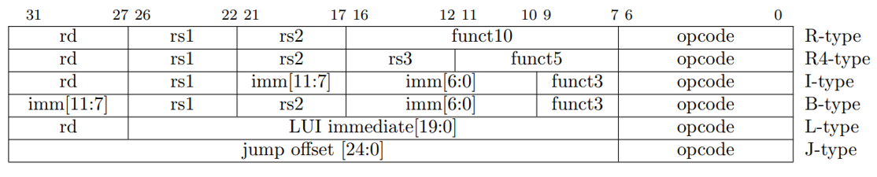
OPERATIONS
In the base ISA, there are six basic instruction formats.
R-type instructions specify two source registers (rs1 and rs2) and a destination register (rd). The funct10 field is an additional opcode field.
R4-type instructions specify three source registers (rs1, rs2, & rs3) and a destination register (rd). The funct5 field is a second opcode field. This format is only used by the floating-point fused multiply-add instructions.
B-type instructions specify two source registers (rs1 and rs2) & a third source operand encoded as a sign-extended 12-bit immediate. The immediate is encoded as the concatenation of the bits 31–27, and bits 16–10. The funct3 field is a second opcode field.
L-type instructions specify a destination register (rd) and a 20-bit immediate value. lui is the only instruction of this format.
I-type instructions specify one source register (rs1) and a destination register (rd). The second source operand is a sign-extended 12-bit immediate. The funct3 field is a second opcode field.
J-type instructions encode a 25-bit jump target address as a PC-relative offset. The 25-bit immediate value is shifted left one bit and added to the current PC to form the target address.

Slide 53
Load and Store Instructions
Floating-Point Instructions
Integer Computational Instructions
Memory Model
System Instructions
Control Transfer Instructions

Slide 54
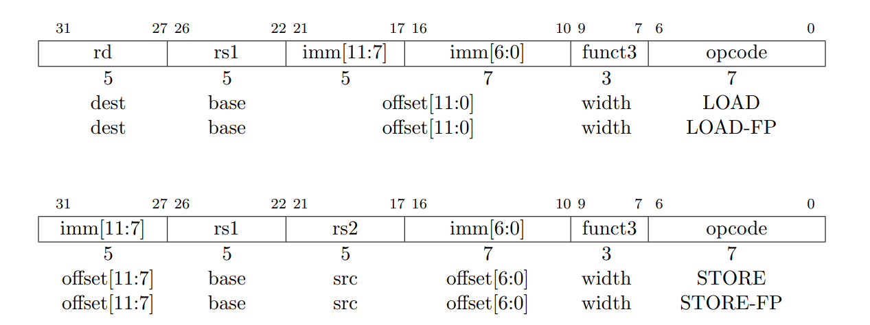
Load & Store Instructions
1/3
Transfer a value between the registers and memory.
Loads are encoded in the I-type format. Stores are B-type.
The effective byte address is obtained by adding register rs1 to the sign-extended immediate.
Loads write to register rd a value in memory. Stores write to memory the value in register rs2.

Slide 55
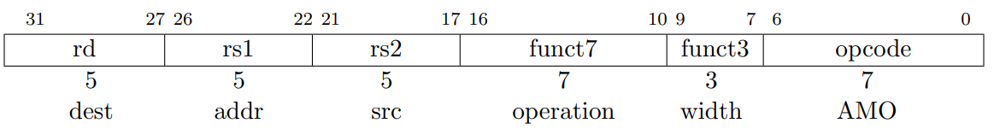
Load & Store Instructions
2/3
Instructions: LD, LW, LWU, LH, LHU, LB, LBU, SD, SW, SH, SB, FLD, FLW, FSD, FSW.
L stands for load & S for store. F also indicates the floating point type of the register. The D, W, H, B letters correspond to the type of the register based on its length. U indicates zero or sign extending of the load instruction.
Atomic Memory Operation Instructions (AMO): perform read-modify-write operations for multiprocessor synchronization and are encoded with an R-type instruction format.

Slide 56
Load & Store Instructions
3/3
AMO atomically load a data value from the address in rs1, place the value into register rd, apply a binary operator to the loaded value and the value in rs2, then store the result back to the address in rs1.
The operations supported are integer add, logical AND, logical OR, swap, and signed and unsigned integer maximum and minimum.

Slide 57
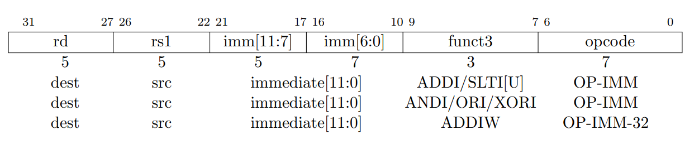
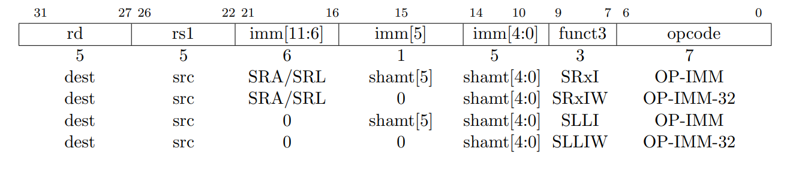
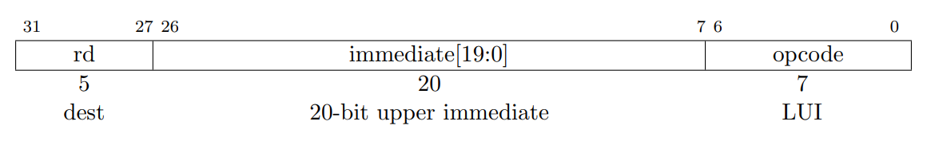
Integer Computational Instructions
1/3
Integer computational instructions are either encoded as register-immediate operations using the I-type format or as register-register operations using the R-type format.
No integer computational instructions cause arithmetic traps.
The destination is register rd for both register-immediate and register-register instructions.

Slide 58
Integer Computational Instructions
2/3
Instructions: ADDI, ADDIW, SLTI, SLTIU, ANDI, ORI, XORI, AND, OR, XOR, SLLI, SRLI, SRAI, SLLIW, SRLIW, SRAIW, LUI.
A stands for arithmetic (e.g. in SRAI the original sign bit is copied into the vacated upper bits).

Slide 59
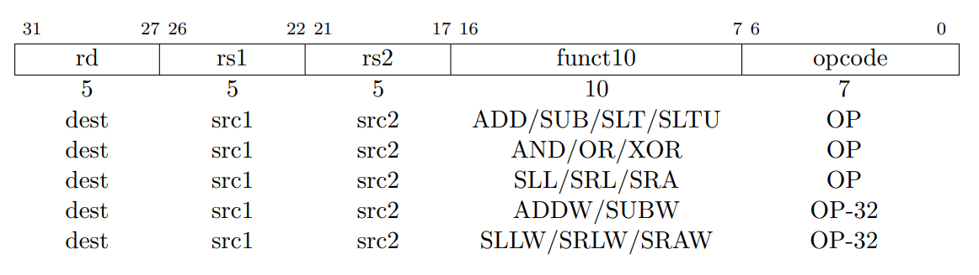
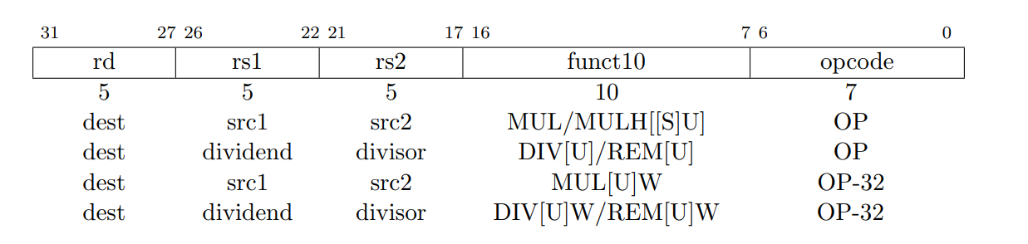
Integer Computational Instructions
3/3
In R-types also, all operations read the rs1 and rs2 registers as source operands and write the result into register rd. The funct field selects the type of operation.
Different multiply and division so of course remainder operations are required for different register lengths & signed or unsigned conditions.

Slide 60
Control Transfer Instructions
1/4
RISC-V provides two types of control transfer instructions: unconditional jumps and conditional branches
Control transfer instructions in RISC-V do not have architecturally visible delay slots.
Absolute jumps (J) and jump and link (JAL) instructions use the J-type format.
The 25-bit jump target offset is sign-extended and shifted left one bit to form a byte offset, then added to the pc to form the jump target address.
Jumps can therefore target a ±32 MB range.
JAL stores the address of the instruction following the jump (pc+4) into register x1.

Slide 61
Control Transfer Instructions
2/4
The indirect jump instruction JALR (jump and link register) uses the I-type encoding.
It has three variants that are functionally identical but provide hints to the implementation:
JALR.C is used to call subroutines;
JALR.R is used to return from subroutines;
JALR.J is used for indirect jumps.
The target address is obtained by sign-extending the 12-bit immediate then adding it to the address contained in register rs1. The address of the instruction following the jump (pc+4) is written to register rd. Register x0 can be used as the destination if the result is not required.

Slide 62
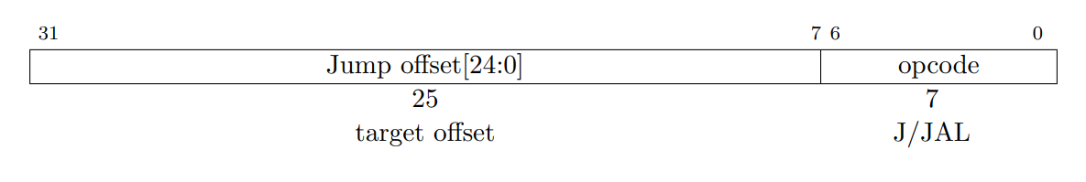
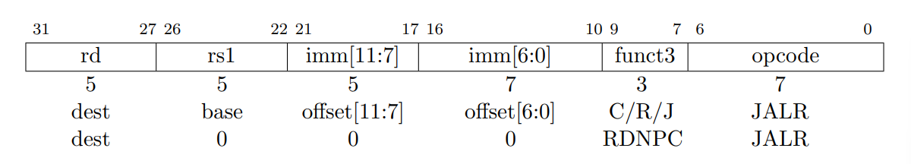
Control Transfer Instructions
3/4
The JALR major opcode is also used to encode the RDNPC instruction, which writes the address of the following instruction (pc+4) to register rd without changing control flow.

Slide 63
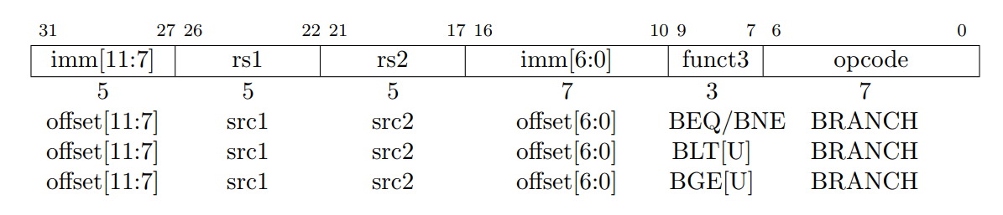
Control Transfer Instructions
4/4
All branch instructions use the B-type encoding.
The 12-bit immediate is sign-extended, shiftedleft one bit, then added to the current pc to give the target address.
BEQ , BNE = Branch Equal, Branch Not Equal
BLT and BLTU = Branch Less Than, Branch Less Than Unsigned
BGE and BGEU = Branch Greater Than, Branch Greater Than Unsigned

Slide 64
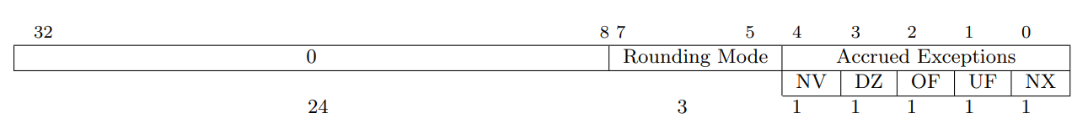
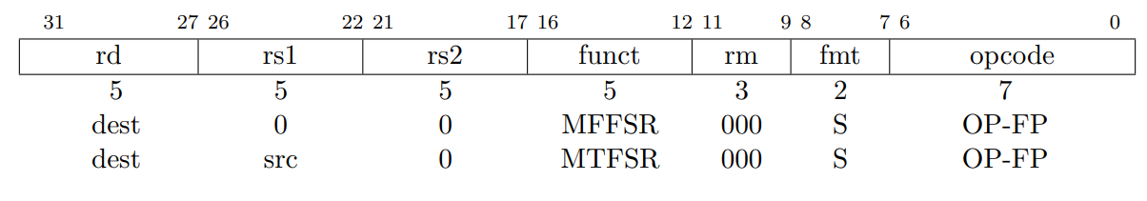
Floating Point Instructions
1/5
The base RISC-V ISA provides both single- and double-precision floating-point computational instructions compliant with the IEEE 754-2008 floating-point arithmetic standard.
The fsr register is a 32-bit read/write register that selects the dynamic rounding mode for floating point arithmetic operations and holds the accrued exception flags.
The fsr is read and written with the MFFSR and MTFSR floating-point instructions.

Slide 65
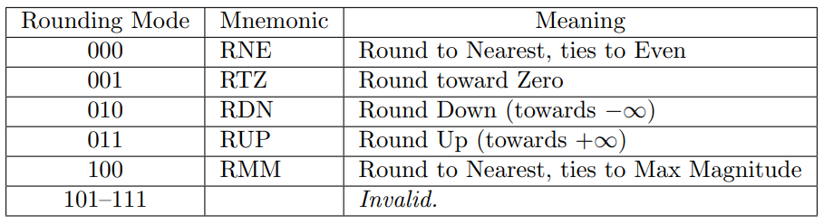
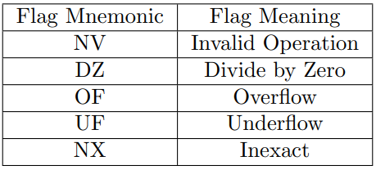
Floating Point Instructions
2/5
Floating-point operations use either a static rounding mode encoded in the instruction, or a dynamic rounding mode held in the Rounding Mode field and encoded as following.
Some instructions are never affected by rounding mode, and should have their rm field set to RNE (000).
The accrued exception flags indicate the exception conditions that have arisen on any floating-point arithmetic instruction.

Slide 66
Floating Point Instructions
3/5
Floating-point arithmetic instructions with one or two source operands use the R-type format with the OP-FP major opcode.
FADD.fmt, FSUB.fmt, FMUL.fmt, and FDIV.fmt perform floating-point addition, subtraction, multiplication, and division, respectively, between rs1 and rs2, writing the result to rd.
FMIN.fmt and FMAX.fmt write, respectively, the smaller or larger of rs1 and rs2 to rd.
FSQRT.fmt computes the square root of rs1 and writes the result to rd.
The fmt field encodes the datatype of the operands and destination: S for single-precision or D for double-precision
All floating-point operations that perform rounding can select the rounding mode statically using the rm field with the same encoding as shown previously. A value of 111 in the instruction’s rm field selects the dynamic rounding mode held in the fsr.

Slide 67
Floating Point Instructions
4/5
Floating-point fused multiply-add instructions are encoded as R4-type instructions.
Multiply the values in rs1 and rs2, optionally negate the result, then add or subtract the value in rs3 to or from that result.
FMADD.fmt computes rs1×rs2+rs3; FMSUB.fmt computes rs1×rs2-rs3; FNMSUB.fmt computes -(rs1×rs2-rs3); and FNMADD.fmt computes -(rs1×rs2+rs3).
Other Instructions: Floating-point-to-integer and integer-to-floating-point conversion instructions, Floating-point to floating-point sign-injection instructions, Instructions to move bit patterns between the floating-point and fixed-point registers, floating-Point Compare Instructions.

Slide 68
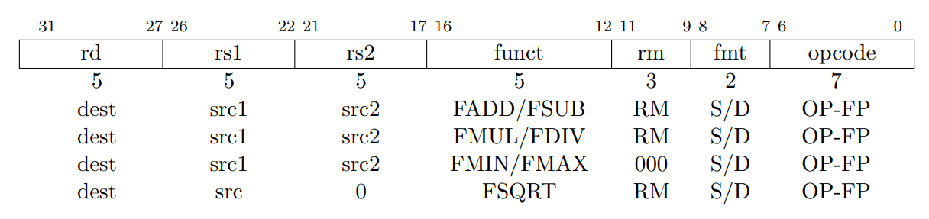
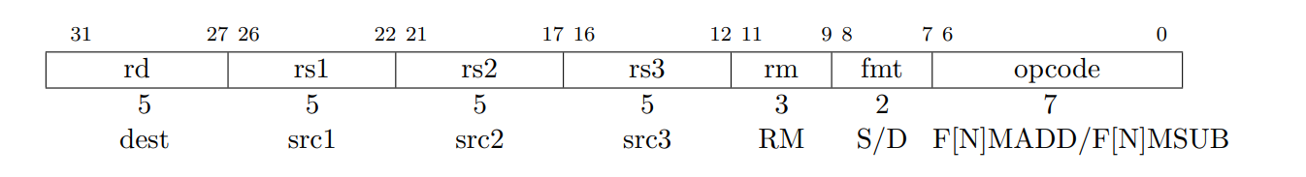
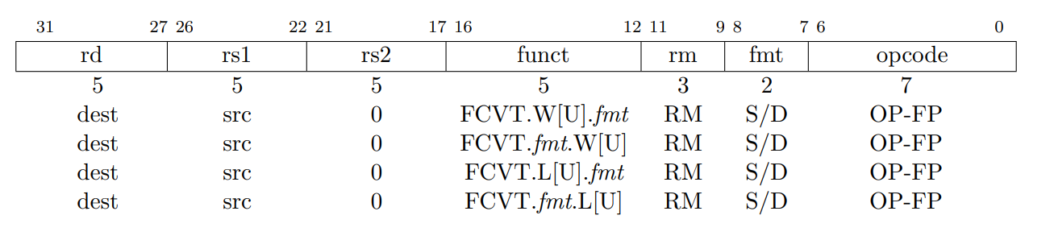
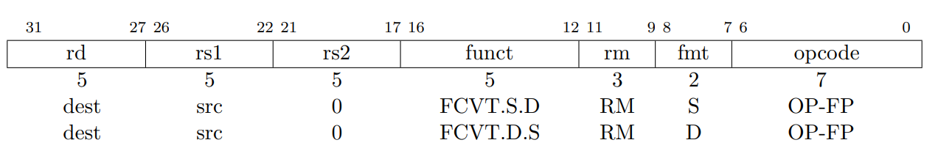
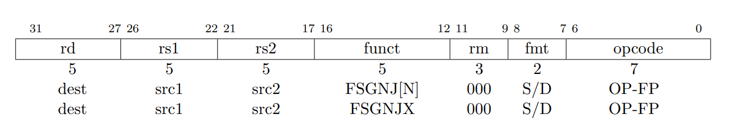
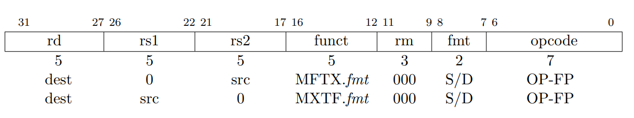
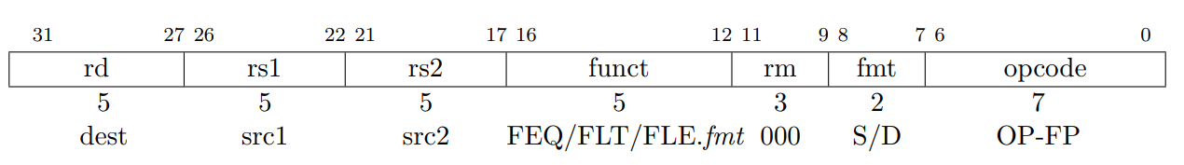
Floating Point Instructions
5/5

Slide 69
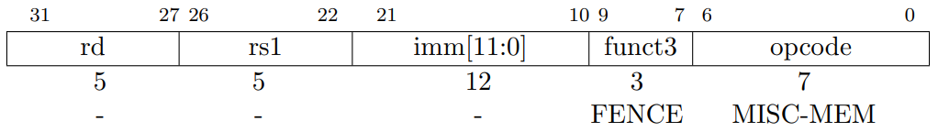
Memory Model
In the base RISC-V ISA, each hardware thread observes its own memory operations as if they executed sequentially in program order.
RISC-V requires an explicit FENCE instruction to guarantee any specific ordering between memory operations from different threads.
No other hardware thread can observe any memory operations following a FENCE before any memory operations preceding the FENCE.
The FENCE instruction is used to order loads and stores as viewed by other hardware threads.

Slide 70
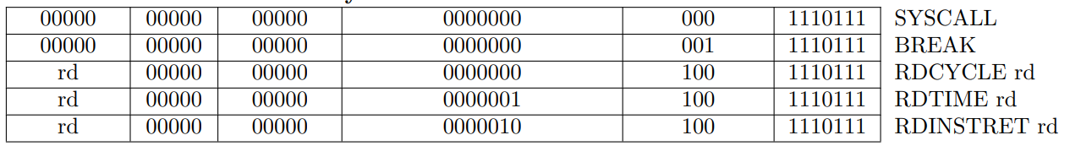
System Instructions
SYSTEM instructions are used to access system functionality that might require privileged access.
Encoded as R-type instructions
SYSCALL: make a request to an operating system environment
BREAK: used by debuggers to cause control to be transferred back to the debugging environment
RDCYCLE: gives the number of clock cycles executed by the processor on which the hardware thread is running from an arbitrary start time in the past
RDTIME: gives the real time that has passed from an arbitrary start time in the past
RDINSTRET: gives the number of instructions retired by this hardware thread from some arbitrary start point in the past

Slide 71
MEMORY MODEL
RISC-V can be implemented with either big-endian or little-
endian memory systems.
Instructions are always stored in a little-endian sequence of parcels regardless of the memory system endianness.
Big Endian: the most significant byte (MSB) of a multi-byte value is stored at the lowest memory address, while the least significant byte (LSB) is stored at the highest memory address
Little Endian: the least significant byte (LSB) of a multi-byte value is stored at the lowest memory address, while the most significant byte (MSB) is stored at the highest memory address.

Slide 72
RISC-V Through Time
RISC-V is an open-source ISA that was developed at the University of California, Berkeley in 2010.
The project was initiated by researchers and faculty members at Berkeley's Parallel Computing Laboratory.
The development of RISC-V was driven by the desire to create a modern, open ISA that could be freely used for both academic research and commercial purposes.
The researchers believed that existing proprietary ISAs, such as ARM and x86, limited innovation and hindered collaboration.
The first version of the RISC-V ISA, known as the "RISC-V Classic“, was designed to be simple and modular, making it easier to implement and customize for various applications and hardware platforms. It provided a small set of instructions, which allowed for efficient pipelining and execution of instructions.
As the RISC-V project gained traction and interest from both academia and industry, the RISC-V Foundation was established in 2015.
The foundation is a non-profit organization dedicated to managing and promoting the RISC-V architecture.

Slide 73
RISC-V Through Time
Since its inception, the RISC-V architecture has undergone several revisions and extensions to enhance its functionality and performance.
These extensions include support for floating-point operations, vector processing, and security features, among others.
The modular nature of RISC-V allows designers to choose the extensions that suit their specific requirements, making it highly customizable.
The open-source nature of RISC-V has fostered a vibrant ecosystem of hardware and software developers, leading to its rapid adoption in various domains.
The development of RISC-V continues to evolve, with ongoing research and industry collaborations driving its growth.

Slide 74
What is Open-Source?
The open-source nature of RISC-V refers to the fact that the architecture's specifications and design are publicly available and freely accessible. This openness brings several advantages

Slide 75
Open-Source Advantages
Education and Research
Collaboration & Innovation
Industry Adoption and Standardization
Reduced Dependency on Proprietary ISAs
Security and Transparency
Customization & Specialization

Slide 76
What is Modular Design?
In a modular design, each module is designed to be independent and self-contained, with well-defined interfaces that allow for communication and interaction with other modules. This allows for flexibility and scalability, as modules can be added, removed, or replaced without affecting the overall system.

Slide 77
The RISC-V ISA is designed with a modular approach, allowing for flexibility and customization based on specific application requirements. The modular design of RISC-V encompasses a base integer instruction set and optional extensions that provide additional functionality. The three commonly used base integer instruction sets are:
RV32I
RV64I
RV128I
- Designed for 32-bit implementations, where the register size and memory addressing are 32 bits.
- Includes 32 general-purpose registers (x0 to x31), where x0 is a constant zero register.
- Provides a set of integer arithmetic and logical operations, load and store instructions, control transfer instructions (branches and jumps), and system-level instructions.
- An extension of RV32I and is designed for 64-bit implementations.
- Extends the register size and memory addressing to 64 bits, providing more addressable memory space.
- Includes the same instructions as RV32I but with wider data paths, allowing for more extensive computations and larger data manipulations.
- Further extends the register size and memory addressing to 128 bits
Catering to systems that require extremely large address spaces or deal with specialized data types
- Includes the same set of instructions as RV64I but with wider data paths and larger register sizes, enabling operations on 128-bit data types.

Slide 78
In addition to the base integer instruction sets, RISC-V allows for optional extensions that provide additional capabilities, such as floating-point operations (F), atomic operations (A), vector processing (V), and cryptography (C), among others. These extensions can be selectively added to the base integer instruction sets to meet specific application requirements, making RISC-V highly customizable and adaptable to various domains and use cases.
Multiply/Divide Extension (M)
Atomic Operations Extension (A)
Floating-Point Extensions (F and D)
- The M extension adds hardware support for integer multiplication and division operations.
- Includes instructions for signed and unsigned multiplication, division, and remainder operations.
- Particularly useful in applications that involve complex arithmetic computations, such as digital signal processing (DSP), graphics, and cryptography.
- The A extension introduces atomic memory operations, which are crucial for multi-threaded or concurrent programming.
- Atomic operations ensure that memory accesses are performed atomically, without interference from other threads or processes.
- Includes instructions for atomic read-modify-write operations, such as atomic compare-and-swap (CAS) and atomic load-linked/store-conditional (LL/SC).
- Add support for single-precision (F) and double-precision (D) floating-point operations, respectively.
- Enable efficient floating-point arithmetic and allow RISC-V processors to perform calculations on real numbers with decimal points.
- Vital for scientific computing, numerical simulations, graphics rendering, and other applications that require high-precision numerical computations.

Slide 79

SiFive offer customizable processor IP solutions based on the RISC-V architecture, enabling companies to design and implement their own RISC-V-based chips.
Western Digital, a major storage technology company, have developed RISC-V-based controllers for flash memory and SSDs, showcasing the applicability of RISC-V in storage systems.
Alibaba, one of the largest e-commerce and cloud computing companies globally, have developed their own RISC-V-based processor, Xuantie, to power their data centers and cloud computing infrastructure.
Google has made investments in the ecosystem. They have explored the use of RISC-V in various projects and initiatives, including hardware security and accelerators for machine learning.
Huawei, a leading telecommunications and consumer electronics company, has joined the RISC-V Foundation and actively participated in the development of the RISC-V ecosystem.
NVIDIA, have utilized RISC-V in their Deep Learning Accelerator (NVDLA) project, which is an open architecture for deep learning inference.
OpenAI, the organization behind ChatGPT, has also utilized RISC-V in its AI research. They have employed RISC-V-based processors in their infrastructure for high-performance computing and AI workloads.
Which companies adopt RISC-V?

Slide 80
ARM
OR
RISC-V

Slide 81
ARM
RISC-V
Instruction Set
Instruction Set
Has a more extensive instruction set with a larger number of instructions and addressing
Modes.
Focuses on a minimalistic, modular, and extensible instruction set. This allows
RISC-V designers to implement only the instructions they need for their specific application, potentially resulting in more efficient and tailored processor designs.
Customization
RISC-V's open-source nature and modular ISA design allow for more customization and
flexibility in processor design compared to ARM. Companies and researchers can develop custom
extensions or create application-specific processor designs that better suit their needs, without being constrained by the licensing terms of a proprietary ISA.

Slide 82
ARM
RISC-V
Area & Cost
RISC‐V processors tend to have smaller die sizes and lower production costs than ARM
processors, making them more suitable for low-power and cost-sensitive applications.
Clock Speed
ARM processors typically have higher clock speeds than RISC‐V processors, which can provide better performance for certain applications, such as high‐performance computing or data-intensive tasks.
Power Consumption
RISC‐V processors generally consume less power than ARM processors due to their
simpler architecture and the ability to customise the ISA to match specific application requirements.
Memory Management Unit (MMU)
ARM processors have advanced memory management units which is not the case in RISC‐V processors. This could be a limitation for some specific applications.

Slide 83
ARM
RISC-V
Licensing model
Licensing model
Companies that want to use ARM‐based processor cores in their products need to obtain a license from ARM Holdings.
Anyone can use, modify, and develop
their own processor designs based on the RISC‐V ISA without the need for a license or royalties.
Ecosystem
Ecosystem
Has a well‐established ecosystem, with a wide range of processor cores available for various performance levels and applications, from low-power microcontrollers to high-performance application processors. ARM‐based processors are used in numerous devices, such as smartphones, tablets, laptops, and embedded systems.
A relatively new ISA, and its ecosystem is still growing. However, it has gained significant traction and support from various companies and organizations, leading to an increasing number of RISC-V-based processor designs and products.

Slide 84
ARM
RISC-V
Security
Security
ARM processors have a proven track record in providing security features such as memory protection and cryptographic acceleration.
RISC‐V processors are still in the process of building similar features.
Usages
The use of RISC‐V is increasing. It has found applications in embedded systems, Internet of Things (IoT) devices, high-performance computing, data centers, and even supercomputers. From microcontrollers to Academic research is using RISC-V.

Slide 85

References
http://www.slideshare.net/
New Bing
chat.openai.com
https://en.wikipedia.org/wiki/Instruction_set_architecture
https://www.slideshare.net/gane309/risc-processors
https://www.slideshare.net/TusharSwami1/risc-reduced-instruction-set-computing?from_search=1
https://www.slideshare.net/MathivananNatarajan/arm-instruction-set-60665439
03-arm_overview.pdf in CW of the Embedded Systems Course
https://en.wikichip.org/wiki/arm_holdings/cortex
https://www.slideshare.net/poedja/introduction-to-arm?from_search=11
https://www.slideshare.net/PrashantSingh056/arm-processor-19617463
https://www.slideshare.net/black_pearl/arm-processor?from_search=0
https://people.eecs.berkeley.edu/~krste/papers/EECS-2011-62.pdf

Slide 86
THE END

